Slide 1
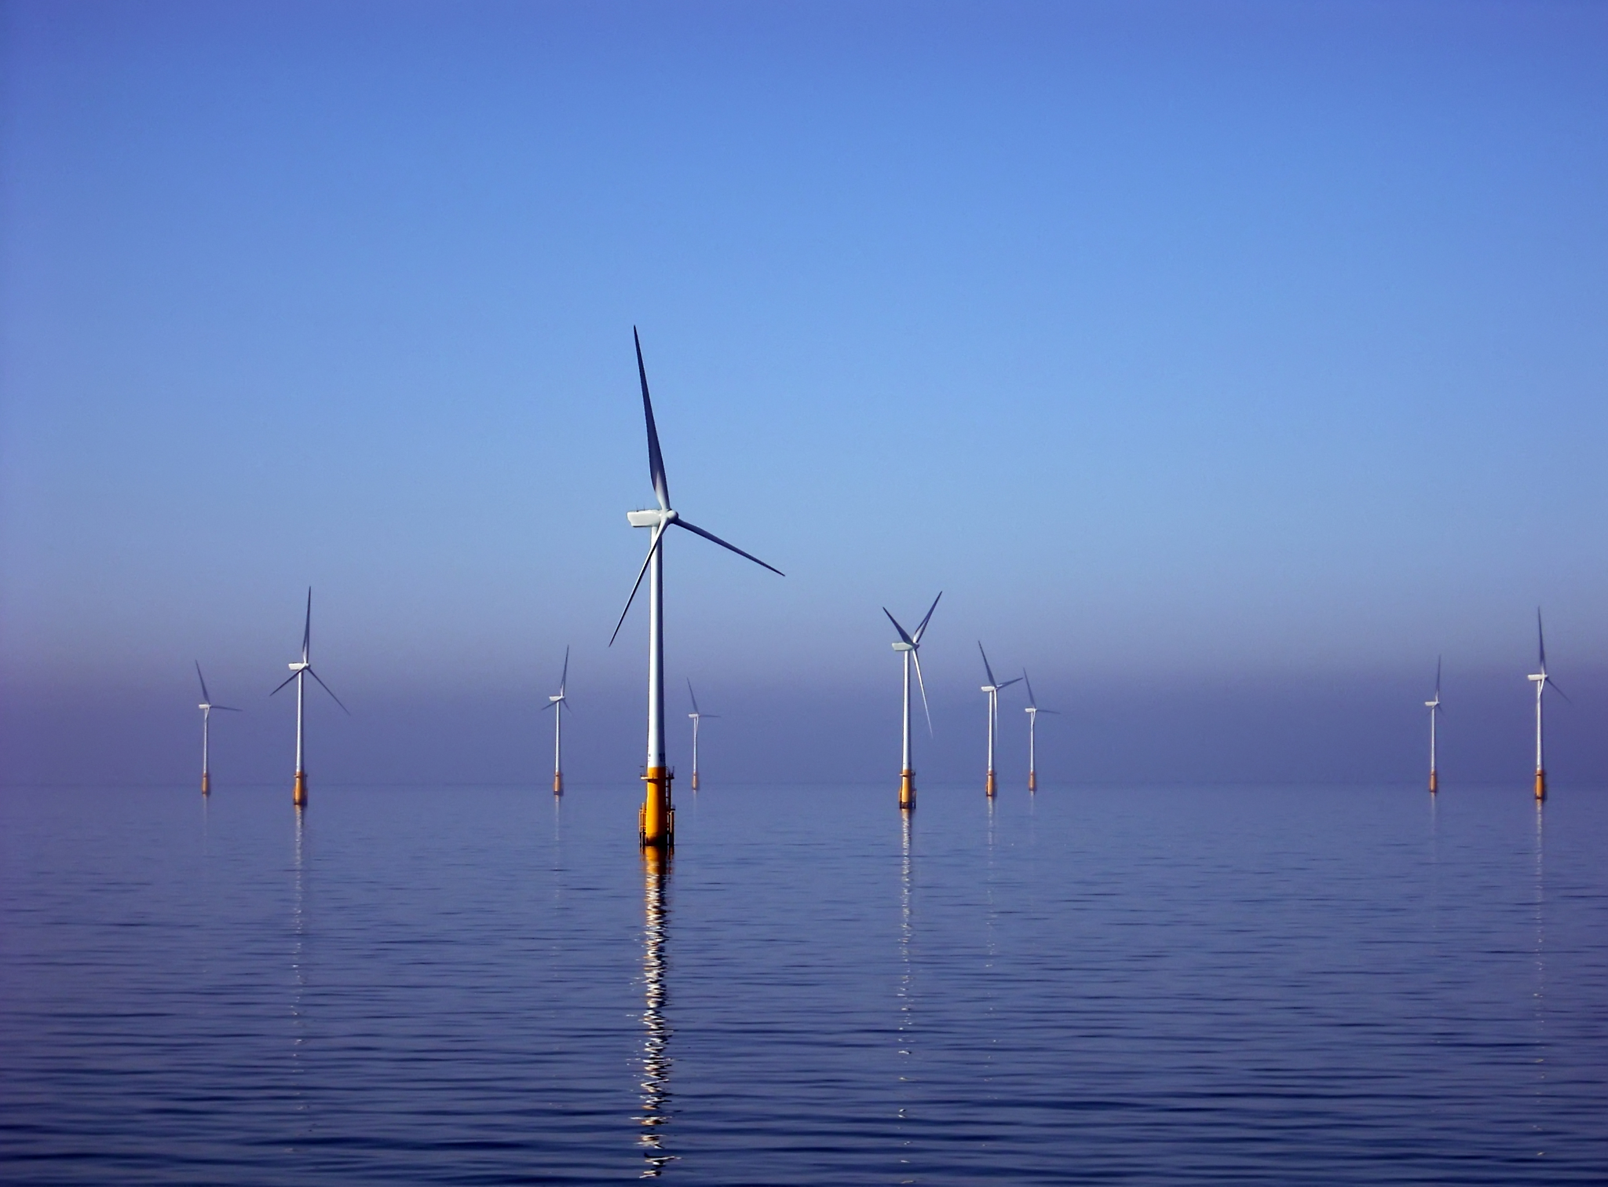
Where to put the Windmills?
Conscientious placement planning of future offshore wind farms in Danish waters
Silas Christian Wilhelm-Leth

Slide 2
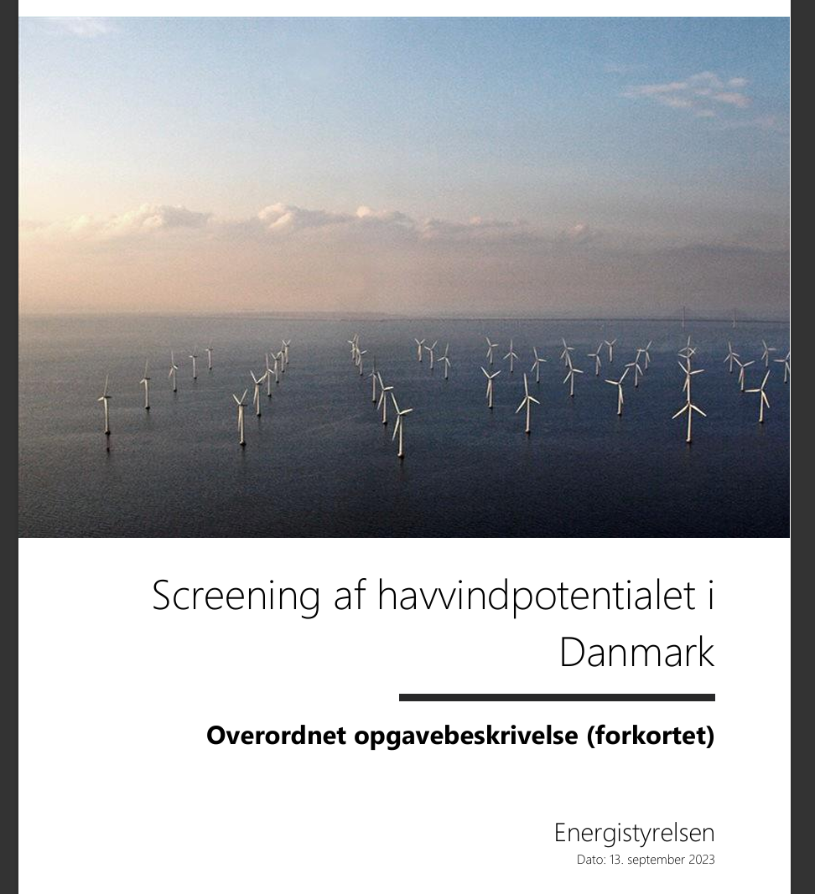
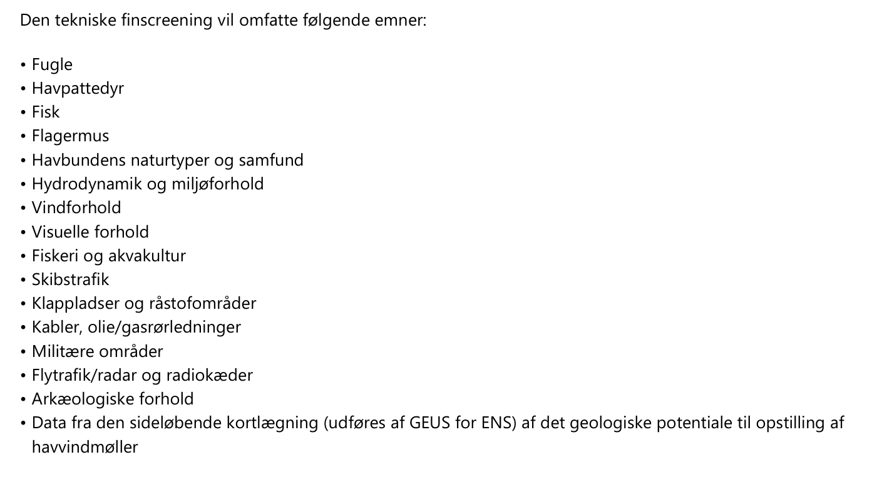
Context:
Currently ongoing screening
(until Q2 2025)
Objective:
Process of elimination → Identifying most suitable areas.
Efficiency
Sustainability
Nature & Infrastructure

Slide 3
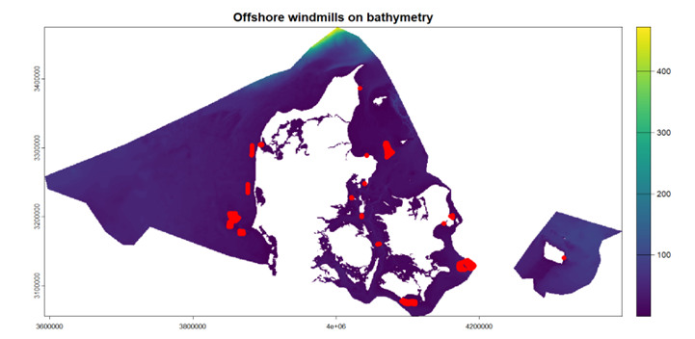
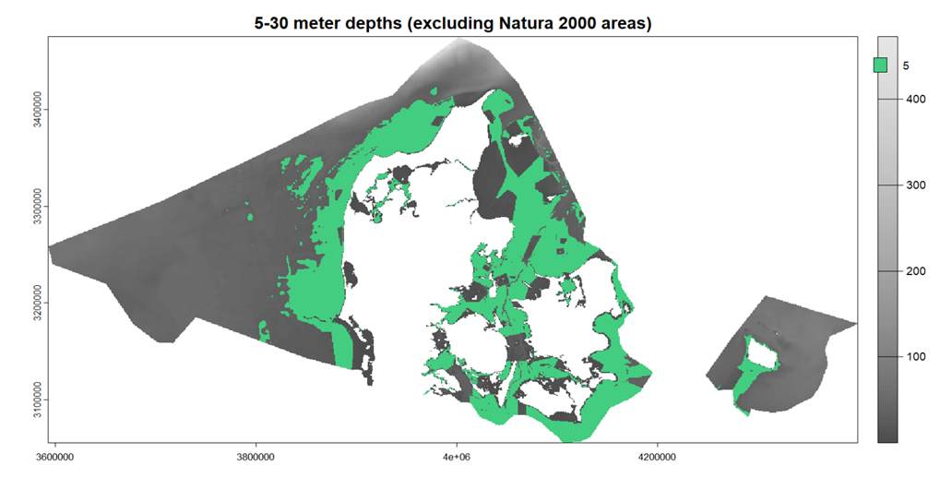
So far:
Depth (placeholder value)
Natura 2000 areas
To-do:
Distance to existing turbines, avoiding wake effect
Existing power grid
Wind conditions
Ferry routes & Shipping lanes

Slide 4
Main limitation: Data
More details in planning by Energistyrelsen:
Wildlife:
Birds, marine mammals, bats, noise concerns,
Infrastructure concerns:
Optimized wind data, hydrodynamic concerns, ocean floor suitability
Replicable method
Non-harmful implementation of the green transition !!

Slide 5
Data:
Danmarks dybdemodel https://dataforsyningen.dk/data/4817#data
Vindkraftanlæg https://dataforsyningen.dk/data/3814
Natura 2000-planer 2022-27 https://mst.dk/erhverv/tilskud-miljoeviden-og-data/data-og-databaser/miljoegis-data-om-natur-og-miljoe-paa-webkort/hent-data-udstillet-paa-miljoegis
Global Wind Atlas: https://globalwindatlas.info/en/
Open Infrastructure Map: https://openinframap.org/#6.47/55.725/10.771 (grid)
Det Marine Danmarkskort: https://geodatastyrelsen.maps.arcgis.com/apps/mapviewer/index.html?webmap=e5495e2f2f674b528c5e74feb3635410 (ferry routes)
References:
Energistyrelsen: https://ens.dk/energikilder/planlaegning-af-fremtidens-havvindmoelleparker
Screening af havvindpotentialet i Danmark Overordnet opgavebeskrivelse (forkortet) Energistyrelsen Dato: 13. september 2023
Dataoversigt og behov for nye data, indre danske farvande og Østersøen Bedre geologiske data til havvindudbygning, Energistyrelsen Lis Allaart, Thomas Vangkilde-Pedersen, Niels Nørgaard-Pedersen, Nicklas Christensen & Jørgen O. Leth
Dataoversigt og behov for nye data, Nordsøen Bedre geologiske data til havvindudbygning, Energistyrelsen Lis Allaart, Thomas Vangkilde-Pedersen, Niels Nørgaard-Pedersen & Jørgen O. Leth
US Department of Energy:
Wind Turbines: the Bigger, the Better: https://www.energy.gov/eere/articles/wind-turbines-bigger-better
How a Wind Turbine Works: https://www.energy.gov/eere/wind/how-wind-turbine-works-text-version
Silas Christian Wilhelm-Leth

